Slide 1
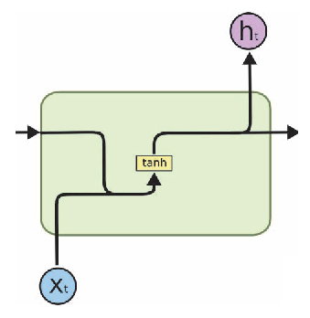
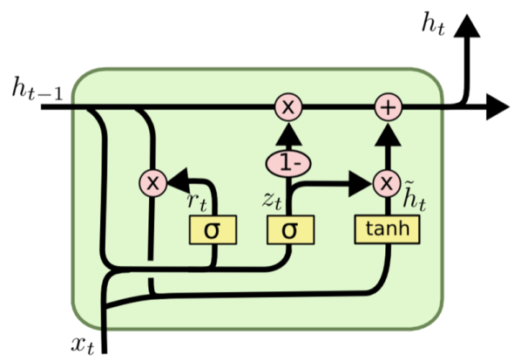
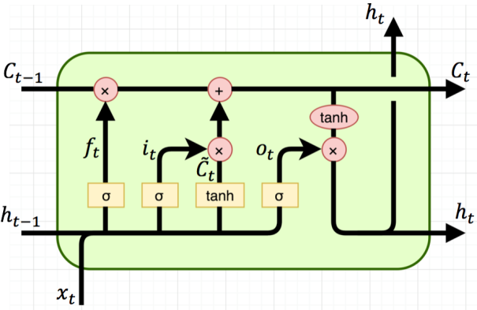
Deep Learning for
Natural Language Processing
Developed by Titus Tang 2020

Slide 2
Workshop Itinerary
Time | Event
09:00 – 09:15 | Arrival and setup
09:15 – 10:15 | Lecture-Demo 1 – Text Processing
10:15 – 10:30 | Break
10:30 – 11:30 | Workshop 1 – Text Processing
11:30 – 11:45 | Break
11:45 – 12:45 | Lecture 2 – Recurrent Neural Networks
12:45 – 13:00 | Break
13:00 – 14:00 | Workshop 2 – Recurrent Neural Networks
14:00 – 14:30 | Question session

Slide 3
Workshop Content – Part 1
Learn to recognise text as data.
Learn how to process text data using various software packages.
Hands-on processing of text data for use in training a neural network.

Slide 4
Workshop Content – Part 2
Learn about recurrent neural networks and how they work.
Build a recurrent neural network using TensorFlow.
Train and test the network using the dataset that you have prepared.
Explore the behaviour and capabilities of the trained model.

Slide 5
Assumed Knowledge
Basic understanding of fundamental deep learning concepts.
Basic Python programming skills.

Slide 6
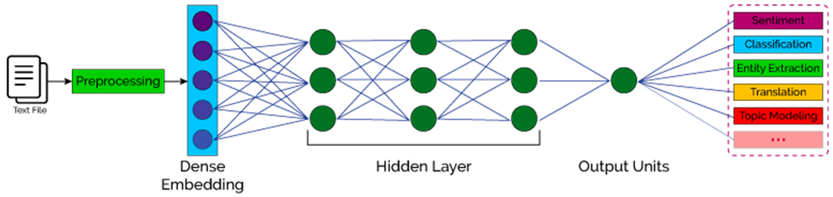
How do neural networks process language (time series) data?
Clean data and define a scope of words: a dictionary.
Machines only work with numbers: convert all words into numbers.
Feed data into network one at a time.
Network must have some concept of memory to remember past words.

Slide 7
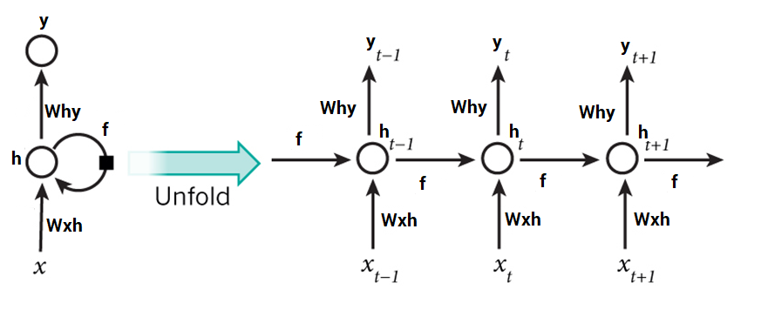
Recurrent Neural Networks
Network design for dealing with time series data.
Each node provides a feedback to itself over time.

Slide 8
Recurrent Neural Networks
This model is too simple.
Needs a more sophisticated model that has:
Control over what is learned.
Ability to forget.
Control over what to output.
Ability to associate ideas related over both short and longer time frames.

Slide 9
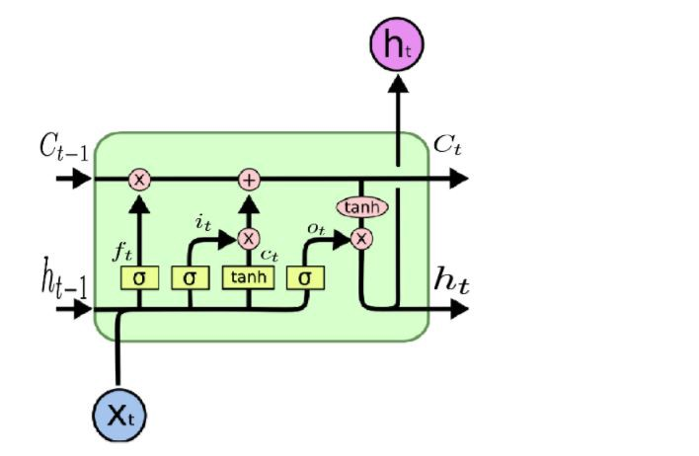
Long Short Term Memory (LSTM)
Cell state (memory)
Forget gate
Cell output
Input gate
Output gate
Avoids the issue of forgetting distant but important information.

Slide 10
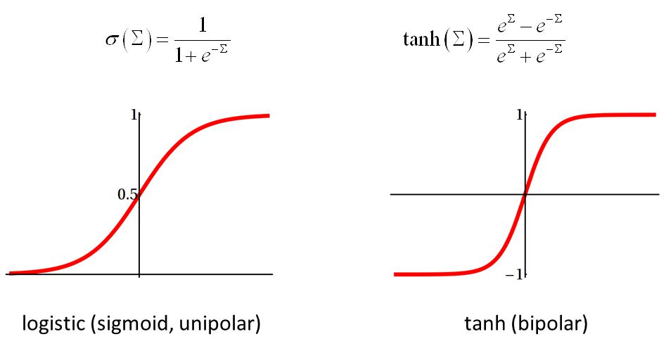
Useful as a switch.
Useful to select a portion of something.
Squeeze all values down to -1 ←→ 1.
Avoids numerical explosion.

Slide 11

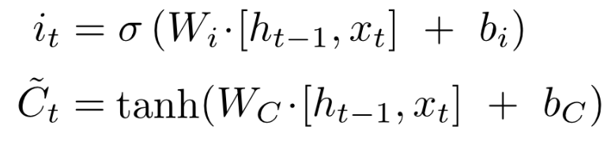

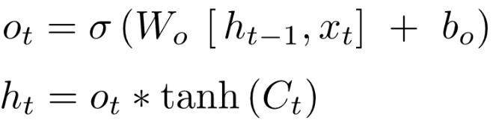
Long Short Term Memory (LSTM)
Cell state
Forget gate
Cell output
Input gate
Output gate

Slide 12
Long Short Term Memory (LSTM)
Portion to forget
Old info
New info
Cell state
Forget gate
Cell output
Input gate
Output gate

Slide 13
Long Short Term Memory (LSTM)
Portion to forget
Old info
New info
Portion to learn
Cell state
Forget gate
Cell output
What to learn
Stuff in memory
New stuff learned
Input gate
Output gate
Stuff remaining

Slide 14
Long Short Term Memory (LSTM)
Portion to forget
Old info
New info
Portion to learn
Cell state
Forget gate
Cell output
What to learn
Stuff in memory
New stuff learned
Input gate
Output gate
Stuff remaining
Portion to output
Output

Slide 15
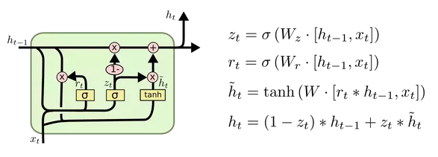
Gated Recurrent Unit (GRU)
Reset gate
Update gate

Slide 16
Gated Recurrent Unit (GRU)
Portion to update
Portion to reset
Reset gate
Existing old and new info
Stuff in Memory
Old info
New info
Update gate

Slide 17
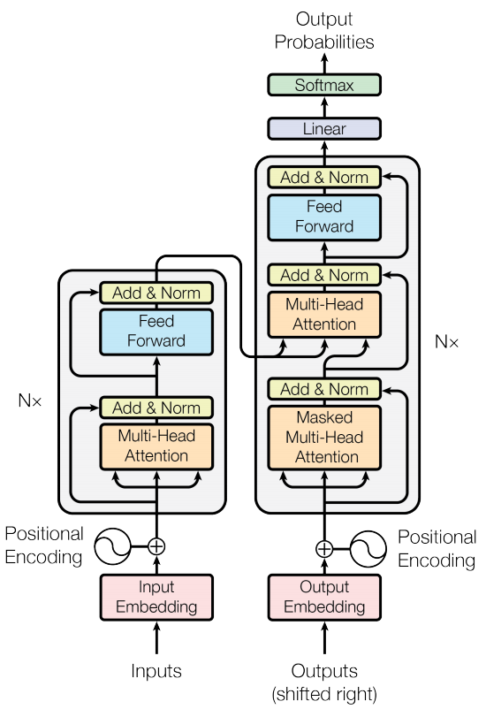
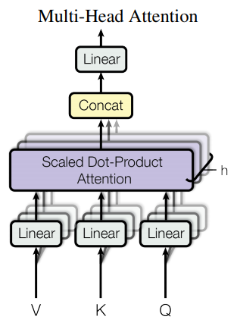
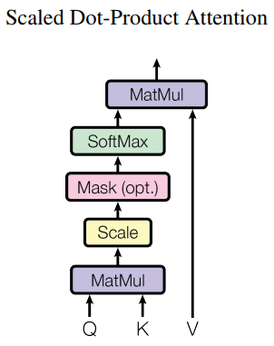
BERT : Bidirectional Encoder Representations from Transformers
Attention mechanism learns what features to pay attention to.
V = Values to pay attention to.
K = Keys weighing importance of values depending on context.
Q = Query – the current context.

Slide 18
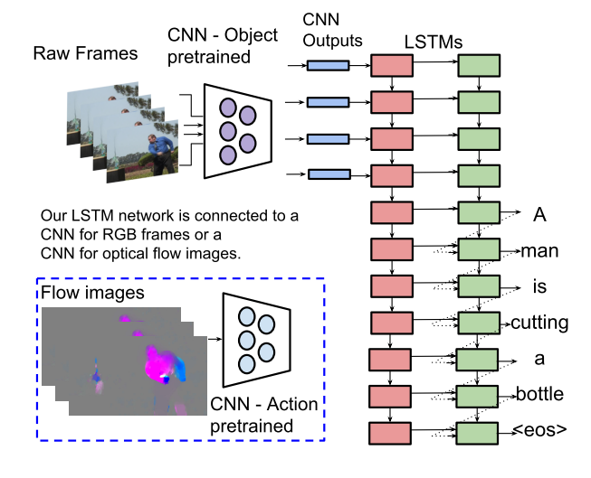
Combining CNNs with LSTMs
Learning how to generate captions for videos.
A CNN summarises information in the image.
LSTM predicts next word based on image and previous word.

Slide 19
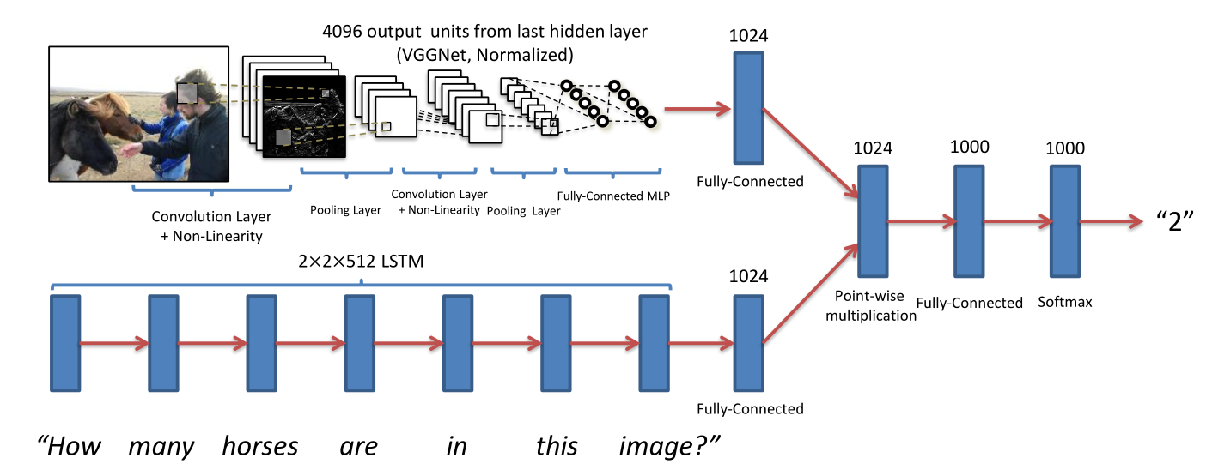
Visual question answering
CNN + LSTM + Fully-connected layers to answer questions based on visual context.

